Slide 1
Few-body problems via Faddeev-Yakubovsky equations formalism
R. Lazauskas

Slide 2
Contents
Solution of the 3-5 body Faddeev-Yakubovsky equations for nuclear systems
Some applications
n-⁴He scattering
Resonances in ⁵H
29/01/2018
2
2
R. Lazauskas
R. Lazauskas
Notes:
2

Slide 3
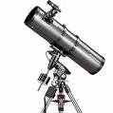
Introduction
Collisions
How to take care of the boundary condition?
Conceptual difficulties to uncouple different particle channel, to constrain assymptotes of the solutions in all directions and thus get unique (physical) solution to the Schrödinger eq.
It is ok, as long as there is single particle channel (elastic plus target/projectile excitations)
Mathematically Ill-conditioned problem when several particle channels are open
Faddeev-Yakubovsky equations efficiently separates asymptotes of the binary channels
In configuration space wave functions extend to infinity!
Increasingly complex asymptotic behaviour for A>2 systems!!
…
L. D. Faddeev, Zh. Eksp. Teor. Fiz. 39, 1459 (1960). [Sov. Phys. JETP 12, 1014(1961)].
O. A. Yakubovsky, Sov. J. Nucl. Phys. 5, 937 (1967).
29/01/2018
3
3
R. Lazauskas
R. Lazauskas
Notes:
3

Slide 4
Properties of the rigorous scattering eq.
Should separate all possible scattering channels to incorporate proper asymptotes! Number of binary channels increases ~2^{N}
Should be systematically reducible to smaller subsystems, in order to built proper asymptotic solutions and to be consistent to its subsystems (tree-like structure)
a
c
$${\vec{r}}_{ab,c}$$
$${\vec{r}}_{ab}$$
b
29/01/2018
4
4
R. Lazauskas
R. Lazauskas
Notes:
4

Slide 5
Faddeev-Yakubovsky eq
3-body
(Faddeev eq.)
4-body
(Faddeev-Yakubovsky eq.)
2
1
j
i
j
i
k
3
k
l
$$φ_{12}=G_{0}V_{12}Ψ$$
l
3
2
1
K-type
(12 components)
H-type
(6 components)
$$φ_{23}=G_{0}V_{23}Ψ$$
$$φ_{jk}=G_{0}V_{jk}Ψ$$
1
3
2
$$K_{ij,k}^{l}=G_{ij}V_{ij}\left(φ_{jk}+φ_{ik}\right); H_{ij}^{kl}=G_{ij}{V_{ij}φ}_{kl}$$
$$φ_{31}=G_{0}V_{31}Ψ$$
$$Ψ=\sum_{i<j}{φ_{ij}=\sum_{i<j}{{(K}_{ij,k}^{l}+{K_{ij,l}^{k}+H}_{ij}^{kl})}}$$
$$Ψ=φ_{12}+φ_{23}+φ_{31}$$
Equations for short-ranged pairwise interactions
29/01/2018
5
5
R. Lazauskas
R. Lazauskas
Notes:
5

Slide 6
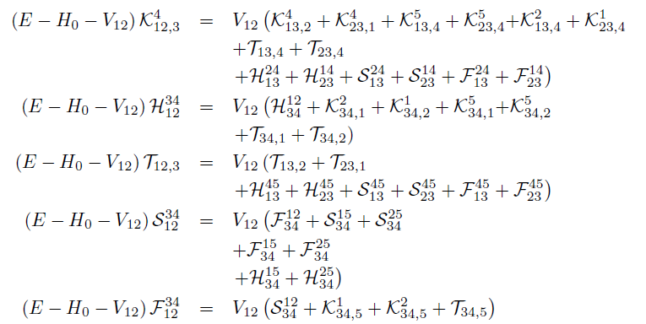
5-body Faddeev-Yakubovski eq
2
1
2
1
2
1
2
1
3
4
3
2
1
3
4
3
4
4
4
3
5
5
5
5
5
29/01/2018
6
6
R. Lazauskas
R. Lazauskas
Notes:
6

Slide 7
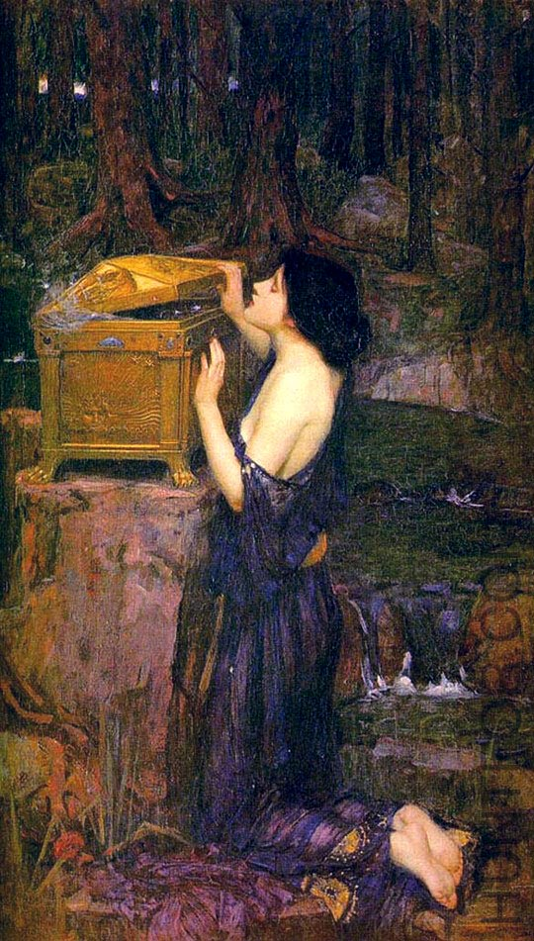
Faddeev-Yakubovsky eq
2
1
2
1
2
1
2
1
3
4
3
2
1
3
4
3
4
4
4
3
5
5
5
5
5
Merits:
Handling of symmetries
Boundary conditions for binary channels
Built-in reduction to subsystems
Price
Overcomplexity
Problem | Number eq. (identical particles) | Number eq. (different particles)
A=2 | 1 | 1
A=3 | 1 | 3
A=4 | 2 | 18
A=5 | 5 | 180
A=6 | 15 | 2700
A=N | nint($\frac{2\left(N−1\right)!}{{(π/2)}^{N}})$ | $$\frac{N!\left(N−1\right)!}{2^{N−1}}$$
J.W. Waterhouse : « Pandora »
29/01/2018
7
7
R. Lazauskas
R. Lazauskas
Notes:
7

Slide 8
5-body Faddeev-Yakubovski eq
2
1
2
1
2
1
2
1
3
4
3
2
1
3
4
3
4
4
4
3
5
5
5
5
5
NUMERICAL SOLUTION
*R.L., PhD Thesis, Université Joseph Fourier, Grenoble (2003).
PW decomposition of the components K,H,T,S,F
Radial parts expanded using Lagrange-mesh method
D. Baye, Physics Reports 565 (2015) 1
Resulting linear algebra problem solved using iterative methods
Observables extracted using integral relations
29/01/2018
8
8
R. Lazauskas
R. Lazauskas
Notes:
8

Slide 9
Numerical costs
2
1
2
1
2
1
2
1
3
4
3
2
1
3
4
3
4
4
4
3
5
5
5
5
5
Problem | Number eq. (ident particles) | Number eq. (diff. particles) | PW basis. | Radial disc.
2N | 1 | 1 | 2 | ~N
3N | 1 | 3 | ~100 | ~N²
4N | 2 | 18 | ~10⁴ | ~N³
5N | 5 | 180 | ~10⁶ | ~N⁴
NUMERICAL SOLUTION
*R.L., PhD Thesis, Université Joseph Fourier, Grenoble (2003).
PW decomposition of the components K,H,T,S,F
Radial parts expanded using Lagrange-mesh method
D. Baye, Physics Reports 565 (2015) 1
Resulting linear algebra problem solved using iterative methods
Observables extracted using integral relations
29/01/2018
9
9
R. Lazauskas
R. Lazauskas
Notes:
9

Slide 10
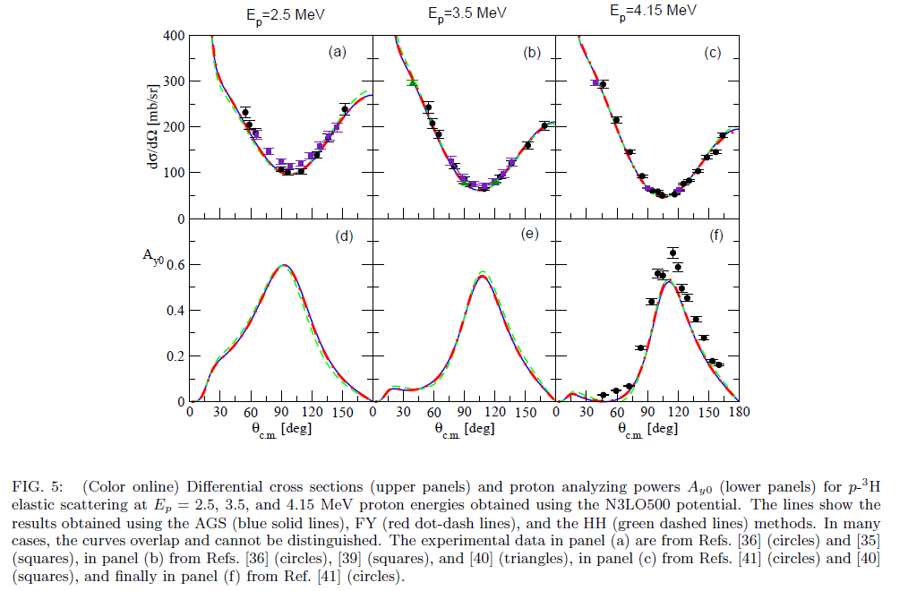
Short overview of nuclear problems by FY eq’s
3N-problem
(Faddeev eq.)
1st solution: A. Laverne and C. Gignoux: Nucl. Phys. A 203 (1973) 597
G. Gignoux, A. Laverne, and S. P. Merkuriev Phys. Rev. Lett. 33 (1974) 1350
Review: W. Glockle et al., Physics Reports 274 ( 1996) 107-285
4N-problem
(Faddeev eq.)
1st solution: S. P. Merkuriev, S.L. Yakovlev, C. Gignoux, Nucl. Phys. A 431 (1984) 125.
Benchmarks: A. Nogga, et al., Phys. Rev. C 65 (2002) 054003 (bound state)
R. Lazauskas et al.,Phys. Rev. C 71 (2005) 034004 (n³H scattering)
M. Viviani et al., Phys. Rev. C 84 (2011) 054010 (p³He scattering)
M. Viviani et al., arXiv:1610.09140 (p³H,n³He scattering)
$$p+^{3}H↔n+^{3}He$$
29/01/2018
10
10
R. Lazauskas
R. Lazauskas
Notes:
10

Slide 11
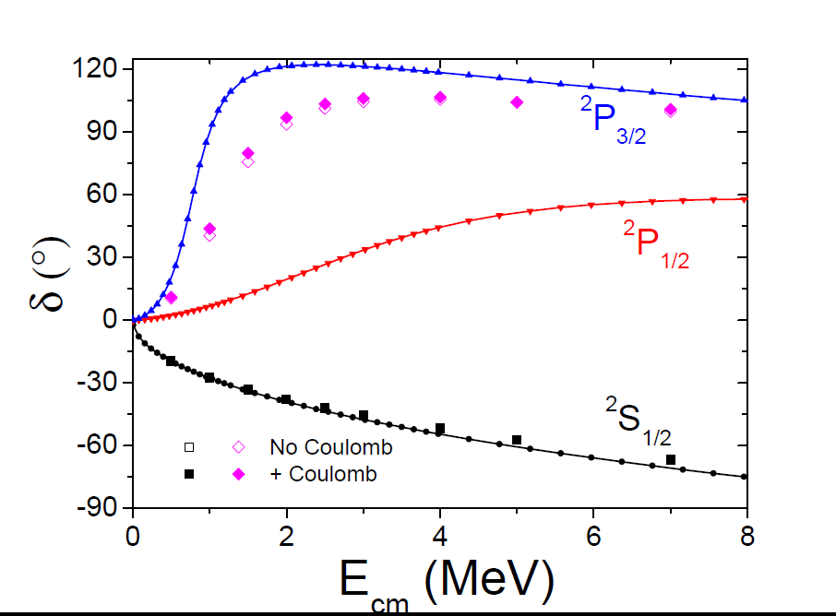
5N problem: n-⁴He scattering
29/01/2018
11
11
R. Lazauskas
R. Lazauskas
Notes:
11

Slide 12
n-⁴He scattering
NCSMC: P. Navratil et al., Physica Scripta 91 (2016) 053002
29/01/2018
12
12
R. Lazauskas
R. Lazauskas
Notes:
12

Slide 13
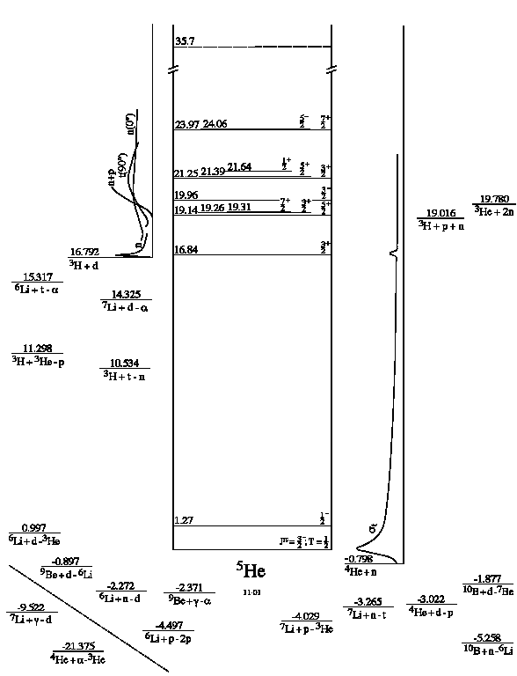
n-⁴He scattering
NCSM: P. Navratil et al., Physica Scripta 91 (2016) 053002
GFMC: K.M. Nollett et. al., Phys.Rev.Lett.99:022502,2007
NCSM-HORSE: A.M. Shirokov et. al., Phys. Rev. C 94, 064320 (2016)
RGM: J. Kircher, PhD work, GWU (2011)
29/01/2018
13
13
R. Lazauskas
R. Lazauskas
Notes:
13

Slide 14
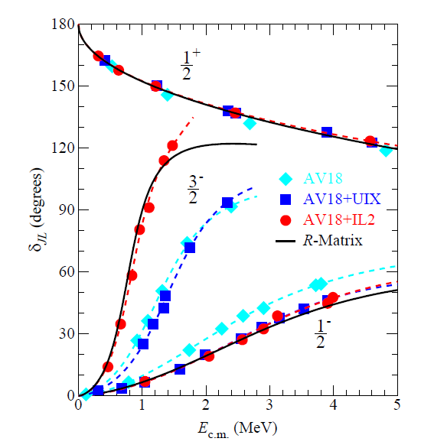
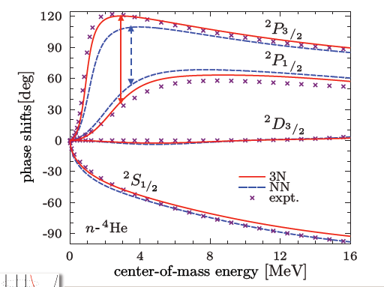
n-⁴He scattering
Idaho N3LO pot.
P. Navratil et al., Physica Scripta 91 (2016) 053002
K.M. Nollett et. al., Phys.Rev.Lett.99:022502,2007
29/01/2018
14
14
R. Lazauskas
R. Lazauskas
Notes:
14

Slide 15
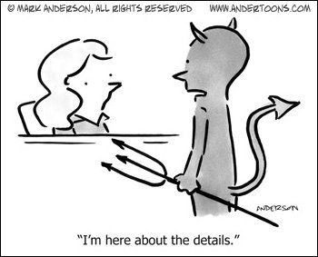
Case of little interest: S-wave
29/01/2018
15
15
R. Lazauskas
R. Lazauskas
Notes:
15

Slide 16
Case of little interest: S-wave
Experimental n-⁴He scattering length …
nothing should be as easy to measure…
NIST (Neutron News 3, 1992)
 | Coh a (fm) | Inc b (fm)
¹H | -3.7406(11) -3.79406(11) | 25.274(9)
²H | 6.671(4) | 4.04(3)
³H | 4.792(27) | -1.04(17)
³He | 5.74(7)-1.483(2)i | -2.5(6)+2.568(3)i
⁴He | 3.26(3) 3.07(2) TUNL
TUNL: D.R. Tilley et al., Nucl. Phys. A708 (2002) 3
NIST: https://www.ncnr.nist.gov
Experimental data:
D.C.Rorer et al., Nucl. Phys. A 133 (1969) 410
S.F.Mughabghab, Atlas of Neutron Resonances (2006)
R.Genin et al., Journal de Physique 24 (1963) 21
29/01/2018
16
16
R. Lazauskas
R. Lazauskas
Notes:
16

Slide 17
Case of little interest: S-wave
TUNL: D.R. Tilley et al., Nucl. Phys. A708 (2002) 3
NIST: https://www.ncnr.nist.gov
S. Ali PSA: S. Ali et al., Rev. Mod. Phys. 57 (1985) 923
Bang-Gignoux pot: J. Bang, C. Gignoux, Nucl. Phys. A 313 (1979) 119
NCSMC: P. Navratil et al., Physica Scripta 91 (2016) 053002
GFMC: K.M. Nollett, PRL99, 022502 (2007)
29/01/2018
17
17
R. Lazauskas
R. Lazauskas
Notes:
17

Slide 18
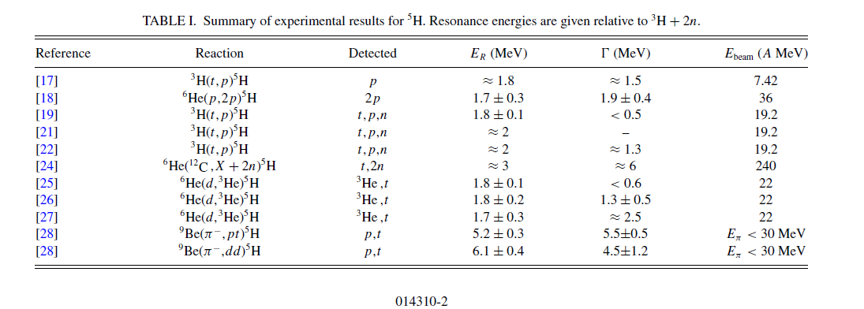
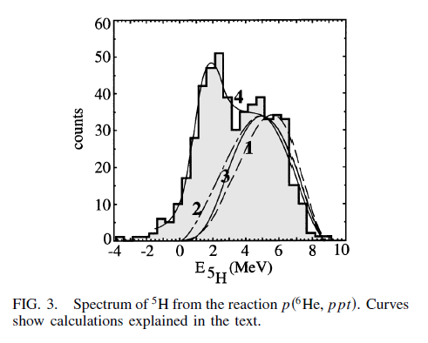
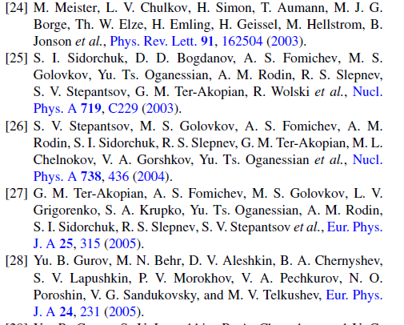
⁵H resonances?
29/01/2018
18
18
R. Lazauskas
R. Lazauskas
Notes:
18

Slide 19
⁵H resonances?
Approximate dynamics of ³H, no full 5-body dynamics
How to handle resonances?
Direct methods with Kapur-Peierls bc .. complicated 3-body boundary condition
Complex scaling
expensive, difficulties with broad resonances
29/01/2018
19
19
R. Lazauskas
R. Lazauskas
Notes:
19

Slide 20
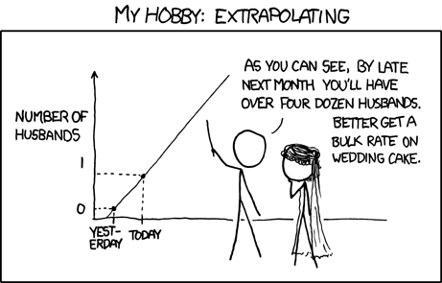
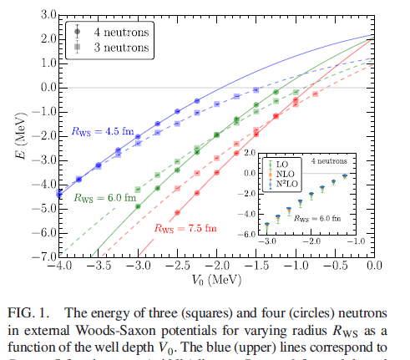
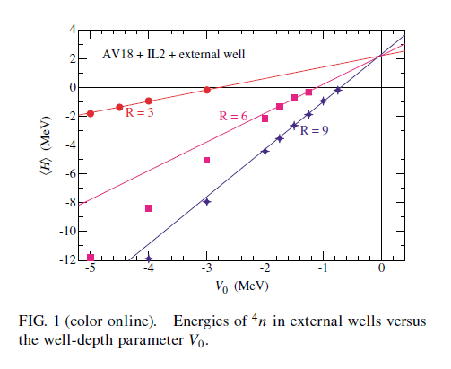
Extrapolation is a flourishing business
29/01/2018
20
20
R. Lazauskas
R. Lazauskas
Notes:
20

Slide 21
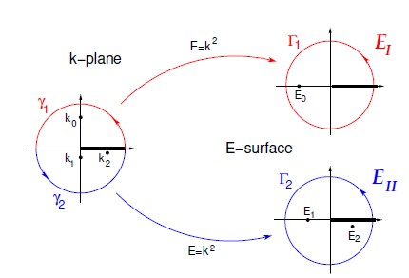
Extrapolation is a flourishing business
In QM scattering problem the « Energy manifold » E is not an axis, but a two-dimensional Riemann sheet!
When moving from bound state region (axis!) to continuum one should take into account the proper analytical behavior: branching points + non-trivial dependence in $k(λV)$
Trajectory of the S-matrix pole with a coupling constant $λ$ with $k\left(λ_{0}\right)=0$
Algebraic branching point $λ{=λ}_{0}$
Bound state
$$λ{>λ}_{0}$$
Anti-resonance
$$λ{<λ}_{0}$$
Resonance
$$λ{<λ}_{0}$$
Analytic behavior in the vicinity of the branching point
$$k(λ→ λ_{0})\sim i\sqrt{λ\text{−} λ_{0}}$$
29/01/2018
21
21
R. Lazauskas
R. Lazauskas
Notes:
21

Slide 22
Extrapolation is a flourishing business
In QM scattering problem the « Energy manifold » E is not an axis, but a two-dimensional Riemann sheet!
When moving from bound state region (axis!) to continuum one should take into account the proper analytical behavior: branching points + non-trivial dependence in $k(λV)$
If it is not done properly… there are some risks
29/01/2018
22
22
R. Lazauskas
R. Lazauskas
Notes:
22

Slide 23
ACCC method
ACCC method (V.I. Kukulin et al., « Theory of resonances », Kluwer AP 1989)
Add artificial binding potential to Hamiltonian $V\left(r\right)$
Calculate several binding energies of the system E_{i}$($_{i})
Determine accurately $0$such that E$(0$)=0 !
Extrapolate E_{res}=E($$=0) using E_{i}$($_{i}) and $0$ values, knowing that
$\sqrt{E_{res}(λ→λ_{0})}\sim i\sqrt{λ−λ_{0}}$
Padé extrapolation is used:
$$\sqrt{E_{res}(λ→λ_{0})}=iP\left[n,m\right]\left(\sqrt{λ−λ_{0}}\right)$$
$$P\left[n,m\right](q)=\frac{a_{1}q+a_{1}q^{2}+..+a_{n}q^{n}}{1+b_{1}q+..+b_{m}q^{m}}$$
2b-example
$$V\left(l=1\right)=−236.5e^{−0.6r^{2}}$$
$$λV(r)=λe^{−r^{2}/3.5}$$
29/01/2018
23
23
R. Lazauskas
R. Lazauskas
Notes:
23

Slide 24
ACCC method
ACCC method (V.I. Kukulin et al., « Theory of resonances », Kluwer AP 1989)
Add artificial binding potential to Hamiltonian $V\left(r\right)$
Calculate several binding energies of the system E_{i}$($_{i})
Determine accurately $0$such that E$(0$)=0 !
Extrapolate E_{res}=E($$=0) using E_{i}$($_{i}) and $0$ values, knowing that
$\sqrt{E_{res}(λ→λ_{0})}\sim i\sqrt{λ−λ_{0}}$
Padé extrapolation is used:
$$\sqrt{E_{res}(λ→λ_{0})}=iP\left[n,m\right]\left(\sqrt{λ−λ_{0}}\right)$$
$$P\left[n,m\right](q)=\frac{a_{1}q+a_{1}q^{2}+..+a_{n}q^{n}}{1+b_{1}q+..+b_{m}q^{m}}$$
2b-example
$$V\left(l=1\right)=−236.5e^{−0.6r^{2}}$$
$$λV(r)=λe^{−r^{2}/3.5}$$
29/01/2018
24
24
R. Lazauskas
R. Lazauskas
Notes:
24

Slide 25
ACCC method
ACCC method (V.I. Kukulin et al., « Theory of resonances », Kluwer AP 1989)
Add artificial binding potential to Hamiltonian $V\left(r\right)$
Calculate several binding energies of the system E_{i}$($_{i})
Determine accurately $0$such that E$(0$)=0 !
Extrapolate E_{res}=E($$=0) using E_{i}$($_{i}) and $0$ values, knowing that
$\sqrt{E_{res}(λ→λ_{0})}\sim i\sqrt{λ−λ_{0}}$
Padé extrapolation is used:
$$\sqrt{E_{res}(λ→λ_{0})}=iP\left[n,m\right]\left(\sqrt{λ−λ_{0}}\right)$$
$$P\left[n,m\right](q)=\frac{a_{1}q+a_{1}q^{2}+..+a_{n}q^{n}}{1+b_{1}q+..+b_{m}q^{m}}$$
2b-example
$$V\left(l=1\right)=−236.5e^{−0.6r^{2}}$$
$$λV(r)=λe^{−r^{2}/3.5}$$
29/01/2018
25
25
R. Lazauskas
R. Lazauskas
Notes:
25

Slide 26
ACCC method
ACCC method (V.I. Kukulin et al., « Theory of resonances », Kluwer AP 1989)
Add artificial binding potential to Hamiltonian $V\left(r\right)$
Calculate several binding energies of the system E_{i}$($_{i})
Determine accurately $0$such that E$(0$)=0 !
Extrapolate E_{res}=E($$=0) using E_{i}$($_{i}) and $0$ values, knowing that
$\sqrt{E_{res}(λ→λ_{0})}\sim i\sqrt{λ−λ_{0}}$
Padé extrapolation is used:
$$\sqrt{E_{res}(λ→λ_{0})}=iP\left[n,m\right]\left(\sqrt{λ−λ_{0}}\right)$$
$$P\left[n,m\right](q)=\frac{a_{1}q+a_{1}q^{2}+..+a_{n}q^{n}}{1+b_{1}q+..+b_{m}q^{m}}$$
2b-example
$$V\left(l=1\right)=−236.5e^{−0.6r^{2}}$$
$$λV(r)=λe^{−r^{2}/2}$$
29/01/2018
26
26
R. Lazauskas
R. Lazauskas
Notes:
26

Slide 27
ACCC method
ACCC method (V.I. Kukulin et al., « Theory of resonances », Kluwer AP 1989)
Add artificial binding potential to Hamiltonian $V\left(r\right)$
Calculate several binding energies of the system E_{i}$($_{i})
Determine accurately $0$such that E$(0$)=0 !
Extrapolate E_{res}=E($$=0) using E_{i}$($_{i}) and $0$ values, knowing that
$\sqrt{E_{res}(λ→λ_{0})}\sim i\sqrt{λ−λ_{0}}$
Padé extrapolation is used:
$$\sqrt{E_{res}(λ→λ_{0})}=iP\left[n,m\right]\left(\sqrt{λ−λ_{0}}\right)$$
$$P\left[n,m\right](q)=\frac{a_{1}q+a_{1}q^{2}+..+a_{n}q^{n}}{1+b_{1}q+..+b_{m}q^{m}}$$
2b-example
$$V\left(l=1\right)=\frac{1.8}{r}\left({1438.72e}^{−3.11r}{−626.885e}^{−1.55r}\right)$$
$$λV(r)=λr^{2}e^{−r^{2}/3.5}$$
29/01/2018
27
27
R. Lazauskas
R. Lazauskas
Notes:
27

Slide 28
ACCC method
ACCC method (V.I. Kukulin et al., « Theory of resonances », Kluwer AP 1989)
Add artificial binding potential to Hamiltonian $V\left(r\right)$
Calculate several binding energies of the system E_{i}$($_{i})
Determine accurately $0$such that E$(0$)=0 !
Extrapolate E_{res}=E($$=0) using E_{i}$($_{i}) and $0$ values, knowing that
$\sqrt{E_{res}(λ→λ_{0})}\sim i\sqrt{λ−λ_{0}}$
Padé extrapolation is used:
$$\sqrt{E_{res}(λ→λ_{0})}=iP\left[n,m\right]\left(\sqrt{λ−λ_{0}}\right)$$
$$P\left[n,m\right](q)=\frac{a_{1}q+a_{1}q^{2}+..+a_{n}q^{n}}{1+b_{1}q+..+b_{m}q^{m}}$$
2b-example
$$V\left(l=1\right)=\frac{1.8}{r}\left({1438.72e}^{−3.11r}{−626.885e}^{−1.55r}\right)$$
$$λV(r)=λr^{2}e^{−r^{2}/3.5}$$
29/01/2018
28
28
R. Lazauskas
R. Lazauskas
Notes:
28

Slide 29
ACCC method
ACCC method (V.I. Kukulin et al., « Theory of resonances », Kluwer AP 1989)
Add artificial binding potential to Hamiltonian $V\left(r\right)$
Calculate several binding energies of the system E_{i}$($_{i})
Determine accurately $0$such that E$(0$)=0 !
Extrapolate E_{res}=E($$=0) using E_{i}$($_{i}) and $0$ values, knowing that
$\sqrt{E_{res}(λ→λ_{0})}\sim i\sqrt{λ−λ_{0}}$
Padé extrapolation is used:
$$\sqrt{E_{res}(λ→λ_{0})}=iP\left[n,m\right]\left(\sqrt{λ−λ_{0}}\right)$$
$$P\left[n,m\right](q)=\frac{a_{1}q+a_{1}q^{2}+..+a_{n}q^{n}}{1+b_{1}q+..+b_{m}q^{m}}$$
2b-example
$$V\left(l=1\right)=\frac{1.8}{r}\left({1438.72e}^{−3.11r}{−626.885e}^{−1.55r}\right)$$
$$λV(r)=λr^{2}e^{−r^{2}/3.5}$$
29/01/2018
29
29
R. Lazauskas
R. Lazauskas
Notes:
29

Slide 30
ACCC method
ACCC method (V.I. Kukulin et al., « Theory of resonances », Kluwer AP 1989)
Add artificial binding potential to Hamiltonian $V\left(r\right)$
Calculate several binding energies of the system E_{i}$($_{i})
Determine accurately $0$such that E$(0$)=0 !
Extrapolate E_{res}=E($$=0) using E_{i}$($_{i}) and $0$ values, knowing that
$\sqrt{E_{res}(λ→λ_{0})}\sim i\sqrt{λ−λ_{0}}$
Padé extrapolation is used:
$$\sqrt{E_{res}(λ→λ_{0})}=iP\left[n,m\right]\left(\sqrt{λ−λ_{0}}\right)$$
$$P\left[n,m\right](q)=\frac{a_{1}q+a_{1}q^{2}+..+a_{n}q^{n}}{1+b_{1}q+..+b_{m}q^{m}}$$
2b-example
$$V\left(l=1\right)=\frac{1.8}{r}\left({1438.72e}^{−3.11r}{−626.885e}^{−1.55r}\right)$$
$$λV(r)=λr^{2}e^{−r^{2}/3.5}$$
29/01/2018
30
30
R. Lazauskas
R. Lazauskas
Notes:
30

Slide 31
Back to ⁵H(J=1/2⁺)
INOY Potential
N₃LO Potential
E(⁵H)-E(³H)=1.65(5)-i1.26(6)
E(⁵H)-E(³H)=1.8(1)-i1.15(15)
29/01/2018
31
31
R. Lazauskas
R. Lazauskas
Notes:
31

